Slide 1
Why ODPi Egeria?
Mandy Chessell, ODPi Egeria Project Leader

Slide 2
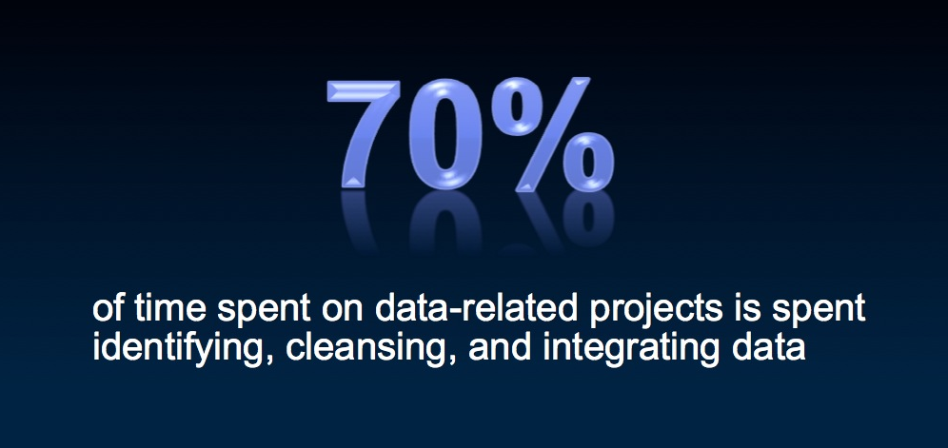
How can we become more effective with data?

Slide 3
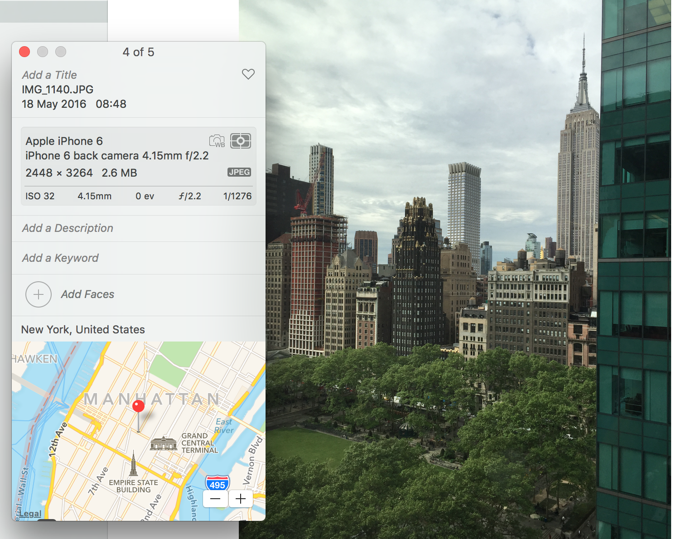
The value of open, standardized metadata
3
Notes:
AUTOMATED – Metadata is created by application at the same as the data is created in a standard manner easily consumable for all with necessary permissions
Device that took the picture / name of picture / settings picture was taken at / location geo tag of picture etc – all automatic – all done at creation of data time

Slide 4

Using a metadata repository to describe data
Metadata
Repository

Slide 5
Today’s reality – organizations buy lots of tools

Slide 6
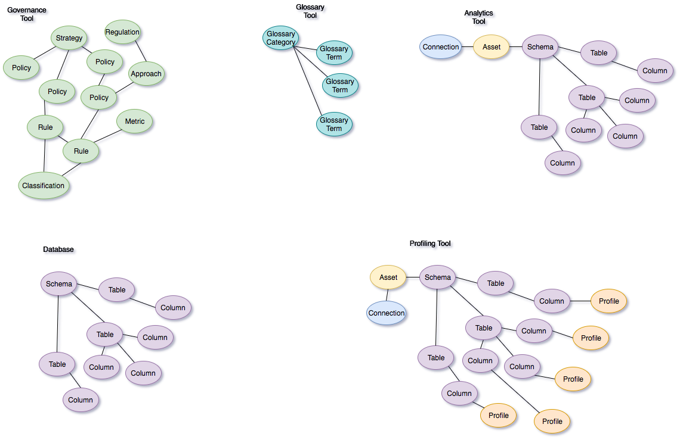

Slide 7
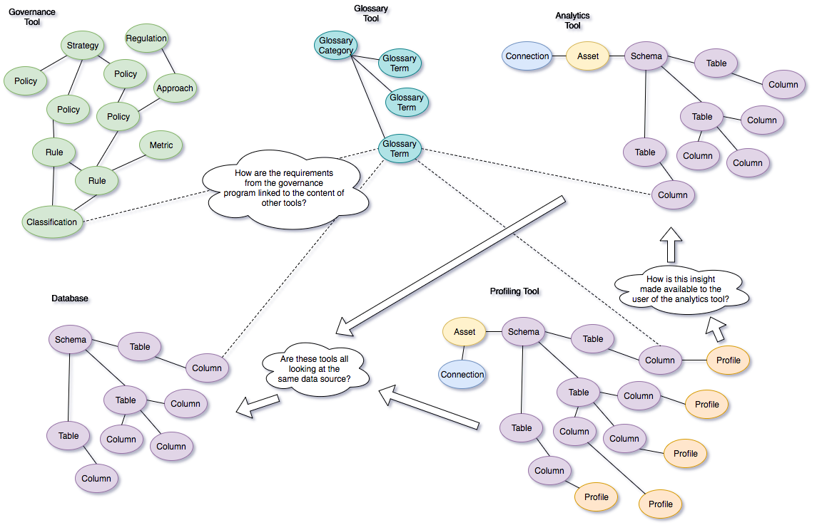

Slide 8
A new manifesto for metadata and governance
The maintenance of metadata must be automated to scale to the sheer volumes and variety of data involved in modern business. Similarly the use of metadata should be used to drive the governance of data and create a business friendly logical interface to the data landscape.
The availability of metadata management must become ubiquitous in cloud platforms and large data platforms, such as Apache Hadoop so that the processing engines on these platforms can rely on its availability and build capability around it.
Metadata access must become open and remotely accessible so that tools from different vendors can work with metadata located on different platforms. This implies unique identifiers for metadata elements, some level of standardization in the types and formats for metadata and standard interfaces for manipulating metadata.
Wherever possible, discovery and maintenance of metadata has to an integral part of all tools that access, change and move information.

Slide 9
ODPi Egeria enables exchange of metadata between tools from different vendors
Development
DevOps
Data Science
Open and
Unified Metadata

Slide 10
Deployment Patterns
Mandy Chessell, ODPi Egeria Project Leader

Slide 11
A hybrid multi-cloud world
Independent metadata Repository
New applications deployed to cloud
Mobile Apps
IoT devices and
systems
Business Partners
Sharing data
Linked metadata Repositories
Data Lake
Applications
Databases
Files
Applications

Slide 12
Open metadata ecosystem
Independent metadata Repository
New applications deployed to cloud
Mobile Apps
IoT devices and
systems
Business Partners
Sharing data
Linked metadata Repositories
Data Lake
Applications
Databases
Files
Applications

Slide 13
The OMAG Server Platform
OMAG Server Platform
OMAG Server Platform
OMAG Server Platform
OMAG Server Platform
Egeria Server 1
OMAG Server Platform
Multi-tenant
Egeria Server 1
Egeria Server 2
Egeria Server 2
Egeria Server 3
Egeria Server 3
Kubernetes
OMAG Server Platform
Egeria Server 1
Edge

Slide 14
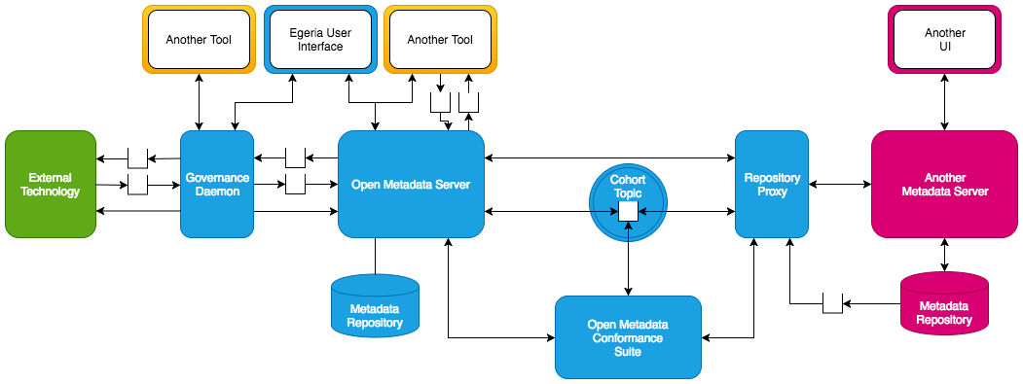
Metadata Tool Integration Patterns

Slide 15
Example of a simple cohort
Gaian
Virtualizer
Data Lake
Chief Data Office
Apache Ranger
Security-Sync
Cohort A
Stewardship
Data Bridge
Systems of Record
Stewardship
Stewardship
Data Onboarding

Slide 16
Community and Ecosystem
Mandy Chessell, ODPi Egeria Project Leader

Slide 17
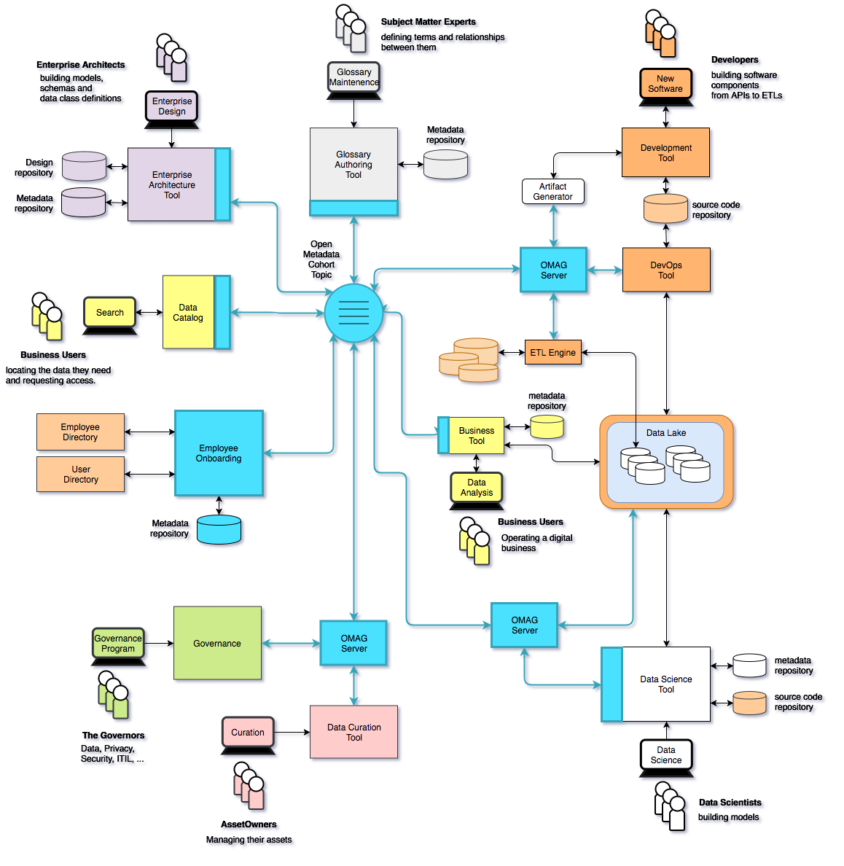
Using ODPi Egeria …
Eases the cost of metadata integration through
Comprehensive standards and libraries.
Active vendor recruitment program.
Provides direct support to many governance roles, filling the gaps between function offered through commercial tools.
Provides best practices and content packs to accelerate an organization’s journey to becoming data driven.

Slide 18
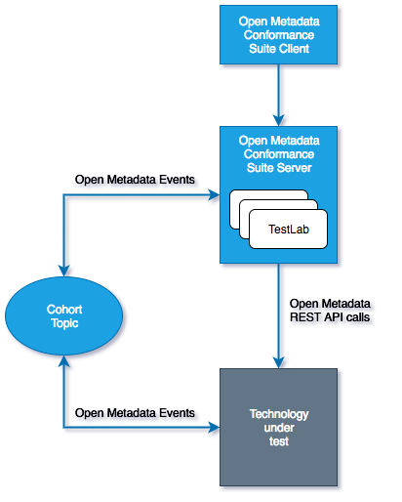
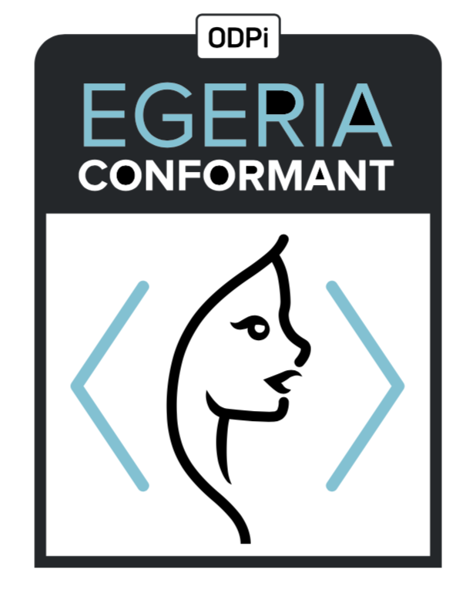
Egeria Conformance Program - its an “imitation game”
Workbench
Vendors that pass the conformance suite can display this mark
Notes:
ODPi

Slide 19
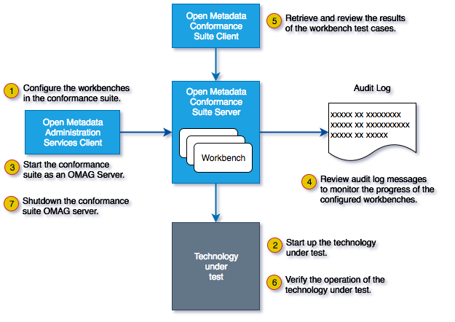
Running the Conformance Suite

Slide 20






The ODPi is a non-profit that is part of The Linux Foundation
Delivering core technology
Recruiting vendors
Assisting practitioners
Core Technology
Vendors
Project
Egeria
Conformance Suite
Practitioners
Best Practices
Project
Data
Governance

Slide 21
Open forum
z
z
z
z
z
z
z
Questions?

Slide 22
Links
Press Releases and Podcast
Open source repositories
https://www.linuxfoundation.org/press-release/2018/08/odpi-announces-egeria-for-open-sharing-exchange-and-governance-of-metadata/
https://www.linuxfoundation.org/press-release/2019/02/odpi-announces-new-egeria-conformance-program-to-advance-open-metadata-exchange-between-vendor-tools/
https://roaringelephant.org/2018/09/25/episode-107-open-metadata-and-governance-masterclass-with-mandy-chessell-part-1/
https://roaringelephant.org/2018/10/09/episode-109-open-metadata-and-governance-
masterclass-with-mandy-chessell-part-2/
https://youtu.be/ryd3KFWT1mc
https://github.com/odpi/data-governance
https://github.com/odpi/egeria
22

Slide 23
Thank You
More information can be found at: https://egeria.odpi.org

Slide 24
Backup
Mandy Chessell, ODPi Egeria Project Leader

Slide 25
Open metadata ecosystem
Mobile Apps
Independent metadata Repository
Linked metadata Repositories
Data Lake
Databases
Files
Applications

Slide 26
Example of a simple cohort
Data Lake
Cohort A
Chief Data Office
Systems of Record

Slide 27
Connecting to multiple cohorts
Data Lake
Marketing
Data Lake
Cohort A
Cohort B
Chief Data Office
Systems of Record
Systems of Record
Mobile
Apps

Slide 28
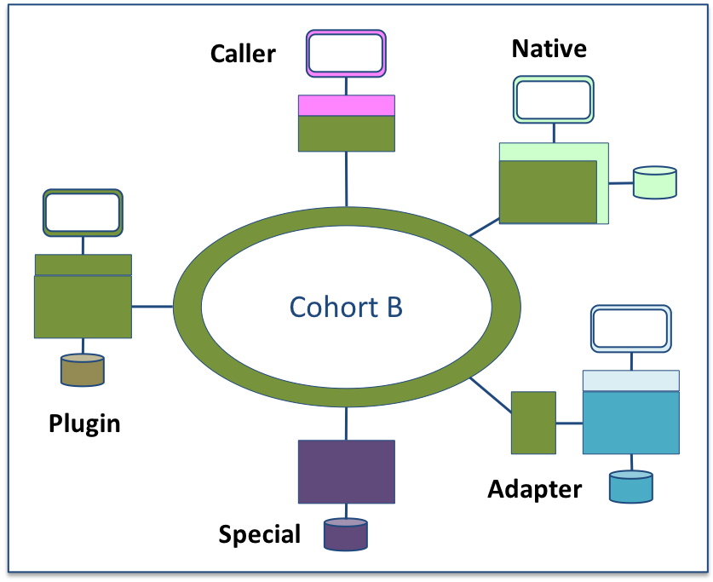
Metadata Repository Integration Patterns
Adapter
Native
Plug-in
Caller
Special

Slide 29
IBM Information Governance Catalog Integration
Egeria’s IGC integration uses the Adapter Pattern
There are two connectors to IGC running in the repository proxy server.
They translate IGC APIs and events into open metadata APIs and events.
Egeria handles the interaction with the cohort.
No need to upgrade IGC to adopt
Outbound metadata only
Repository Proxy
Information
Governance
Catalog
ODPi Egeria
Repository Connector
Event Mapper Connector
Open Metadata Highway

Slide 30
Apache Atlas Integration
The Egeria community is working on a similar integration for Apache Atlas.
Again there are two connectors in the repository proxy server.
These connectors translate Atlas APIs and events into open metadata APIs and events.
Egeria handles the interaction with the cohort.
No need to upgrade Atlas to adopt
Two-way exchange of native Atlas metadata
Repository Proxy
Apache Atlas
ODPi Egeria
Repository Connector
Event Mapper Connector
Open Metadata Highway

Slide 31
Native Integration
An alternative approach is the Native Pattern
There are still two connectors. They translate internal APIs and events into open metadata APIs and events.
ODPi Egeria handles the interaction with the cohort.
The connectors and the ODPi Egeria libraries reside in the metadata server.
No additional server; less network traffic; upgrade required.
ODPi Egeria
Metadata
Server
Repository Connector
Event Mapper Connector
Open Metadata Highway

Slide 32
Plug-in Integration
The plug-in pattern allows different repository back-ends to be plugged into the ODPi Egeria’s OMAG Server.
Egeria includes:
In-memory Repository (Testing and demos)
JanusGraph Repository (All scenarios)
Supports the full protocol and fills in the gaps left by the proprietary tools.
Open Metadata and Governance (OMAG)
Server
Repository Connector
Open Metadata Highway

Slide 33
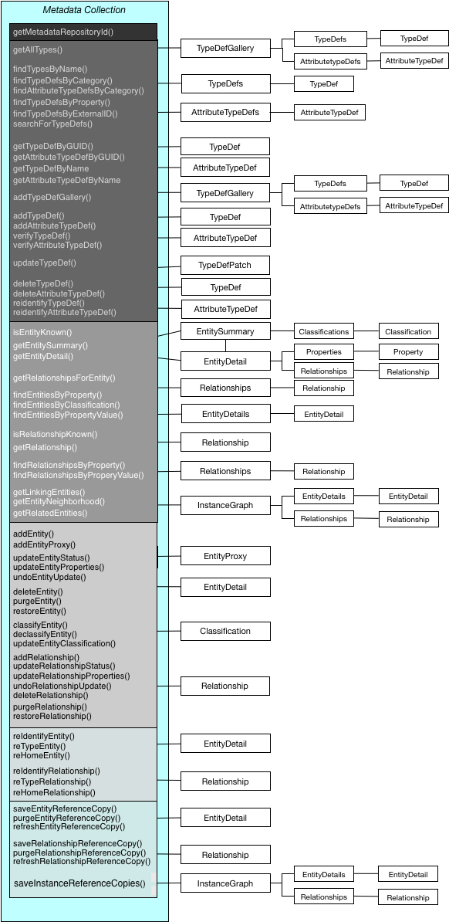
Metadata Repository API
Interface is comprehensive – best of breed
Metadata collection Id
Query types
Define/maintain types
Search/query metadata instances
Maintain metadata instances
Historical (as of time) queries
Effectivity dating
Versioning
Metadata
Advanced maintenance
Managing reference copied
Protocol is forgiving – allowing minimal capability - metadata instance search/query

Slide 34
Example of a simple cohort
Data Lake
Cohort A
Chief Data Office
Systems of Record

Slide 35
First server
The first server to join the cohort issues a registration request and waits for others to join.

Slide 36
Establishing contact
When another server joins the cohort they exchange registration information.

Slide 37
Federated queries
Once the registration is complete the cohort members can query each other.

Slide 38
Caching metadata for availability and performance
Metadata can also be replicated through the cohort

Slide 39
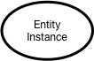
Instance representations in the repository services

Slide 40
Importance of the distributed graph model
Database
Column
Glossary Term
Server 1
Server 2
Entity
Entity

Slide 41
Importance of the distributed graph model
Database
Column
Glossary Term
Glossary
Term
Meaning
Server 1
Server 2
Reference
Copy
Relationship

Slide 42
Importance of the distributed graph model
Database
Column
Glossary
Term
Server 1
Server 2
Database Column
Glossary
Term
Meaning
Server 3

Slide 43
Importance of the distributed graph model
Database
Column
Glossary
Term
Server 1
Server 2
Entity
Proxy
Database
Column
Glossary
Term
Meaning
Server 3

Slide 44
Scope of metadata covered
Governance
Glossary
Collaboration
Models and
Reference Data
Lineage
Metadata
Discovery
Data Assets
Base Types, Systems
and Infrastructure

Slide 45
Scope of metadata covered
Strategy
4
Subject Area Definition
1
Teaming Metadata
(people profiles, communities, projects,
notebooks, …)
Policy Metadata (Principles, Regulations, Standards, Approaches, Rule Specifications, Roles and Metrics)
Business Objects and Relationships, Taxonomies and Ontologies
Augmentation
3
Organization
Feedback Metadata
(tags, comments, ratings, …)
Rollout
Classification
Business Attributes
Campaigns and Projects
Classification Schemes
Implementation
Mapping
Governance Actions and Processes
Rights
Management
Models and Schemas
2
Asset Collections
(Sets, Typed Sets, Type Organized Sets)
Reference Data
5
Instrument
7
Information Process
Instrumentation (design lineage)
Association
Information Views
Augmentation
Discovery
Metadata (profile data, technical classification, data classification,
data quality assessment, …)
Physical Asset Descriptions
(Data stores, APIs,
models and components)
0
Basic Types, Infrastructure and Systems
Access
6
Connectors

Slide 46
Metadata and governance digital platform
Governance Platform
Reporting Platform
Analytics Platform
Open Metadata and Governance
Data Platform
ETL Platform
Virtualization Platform

Slide 47
Design philosophy
Use cases,
Personas,
Practitioners
input
Search
Open Metadata Access Services
Open Metadata Repository Services
Data integration, availability and integrity best practices

Slide 48
Through the Repository Services
{
"class": "EntityDetailResponse",
"relatedHTTPCode": 200,
"entity": {
"class": "EntityDetail",
"type": {
"class": "InstanceType",
"typeDefCategory": "ENTITY_DEF",
"typeDefGUID": "578a3510-9ad3-45fe-8ada-e4e9572c37c8",
"typeDefName": "GovernanceOfficer",
"typeDefVersion": 1,
"typeDefDescription": "Person responsible for a governance domain.",
"typeDefSuperTypes": [
{
"guid": "a32316b8-dc8c-48c5-b12b-71c1b2a080bf",
"name": "Referenceable"
}
],
"validInstanceProperties": [
"qualifiedName",
"additionalProperties",
"title",
"scope",
"domain"
]
},
"createdBy": "julesk",
"createTime": "2018-09-11T13:01:20.139+0000",
"version": 1,
"instanceProvenanceType": "LOCAL_COHORT",
"metadataCollectionId": "87b06ffe-9db2-4ef5-ba6e-8127480cf30d",
"guid": "fd7d41e7-70f5-42ec-86d3-88683e599494",
"instanceURL": "http://localhost:8080/instances/entity/fd7d41e7-70f5-42ec-86d388683e599494",
"properties": {
"class": "InstanceProperties",
"instanceProperties": {
"title": {
"class": "PrimitivePropertyValue",
"instancePropertyCategory": "PRIMITIVE",
"primitiveDefCategory": "OM_PRIMITIVE_TYPE_STRING",
"primitiveValue": "Chief Data Officer (CDO)"
},
"qualifiedName": {
"class": "PrimitivePropertyValue",
"instancePropertyCategory": "PRIMITIVE",
"primitiveDefCategory": "OM_PRIMITIVE_TYPE_STRING",
"primitiveValue": "EXEC-CDO"
},
"domain": {
"class": "EnumPropertyValue",
"instancePropertyCategory": "ENUM",
"ordinal": 1,
"symbolicName": "Data",
"description": "The data (information) governance domain."
}
},
"propertyNames": [
"qualifiedName",
"domain",
"title"
],
"propertyCount": 3
},
"status": "ACTIVE"
}
}
http://localhost:8080/open-metadata/repository-services/users/julesk/instances/entity/fd7d41e7-70f5-42ec-86d3-88683e599494
Type
Control
Properties

Slide 49
Through the governance program access service
{
"class": "GovernanceOfficerResponse",
"relatedHTTPCode": 200,
"governanceOfficer": {
"class": "GovernanceOfficer",
"guid": "fd7d41e7-70f5-42ec-86d3-88683e599494",
"type": "GovernanceOfficer",
"title": "Chief Data Officer (CDO)",
"governanceDomain": "DATA",
"appointmentId": "EXEC-CDO",
"appointee": {
"guid": "0760ac98-69e2-4309-ab1d-53377b105d0a",
"type": "GovernancePost",
"profile": {
"guid": "053435b5-b19f-434d-bdd5-f6c909f55cb3",
"type": "Person",
"employeeNumber": "026",
"fullName": "Julian Keeper",
"knownName": "Jules Keeper",
"jobTitle": "Chief Data and Privacy Officer",
"jobRoleDescription": "Ensuring CocoP makes the best use of data.",
"additionalProperties": {
"ContactType": "Employee",
"WorkLocation": 2
}
}
}
}
}
http://localhost:8080/open-metadata/access-services/governance-program/users/julesk/leadership/governance-officers/fd7d41e7-70f5-42ec-86d3-88683e599494
Governance Officer
Governance Post
Person

Slide 50
Coco Pharmaceuticals persona
https://odpi.github.io/data-governance/coco-pharmaceuticals/personas/

Slide 51
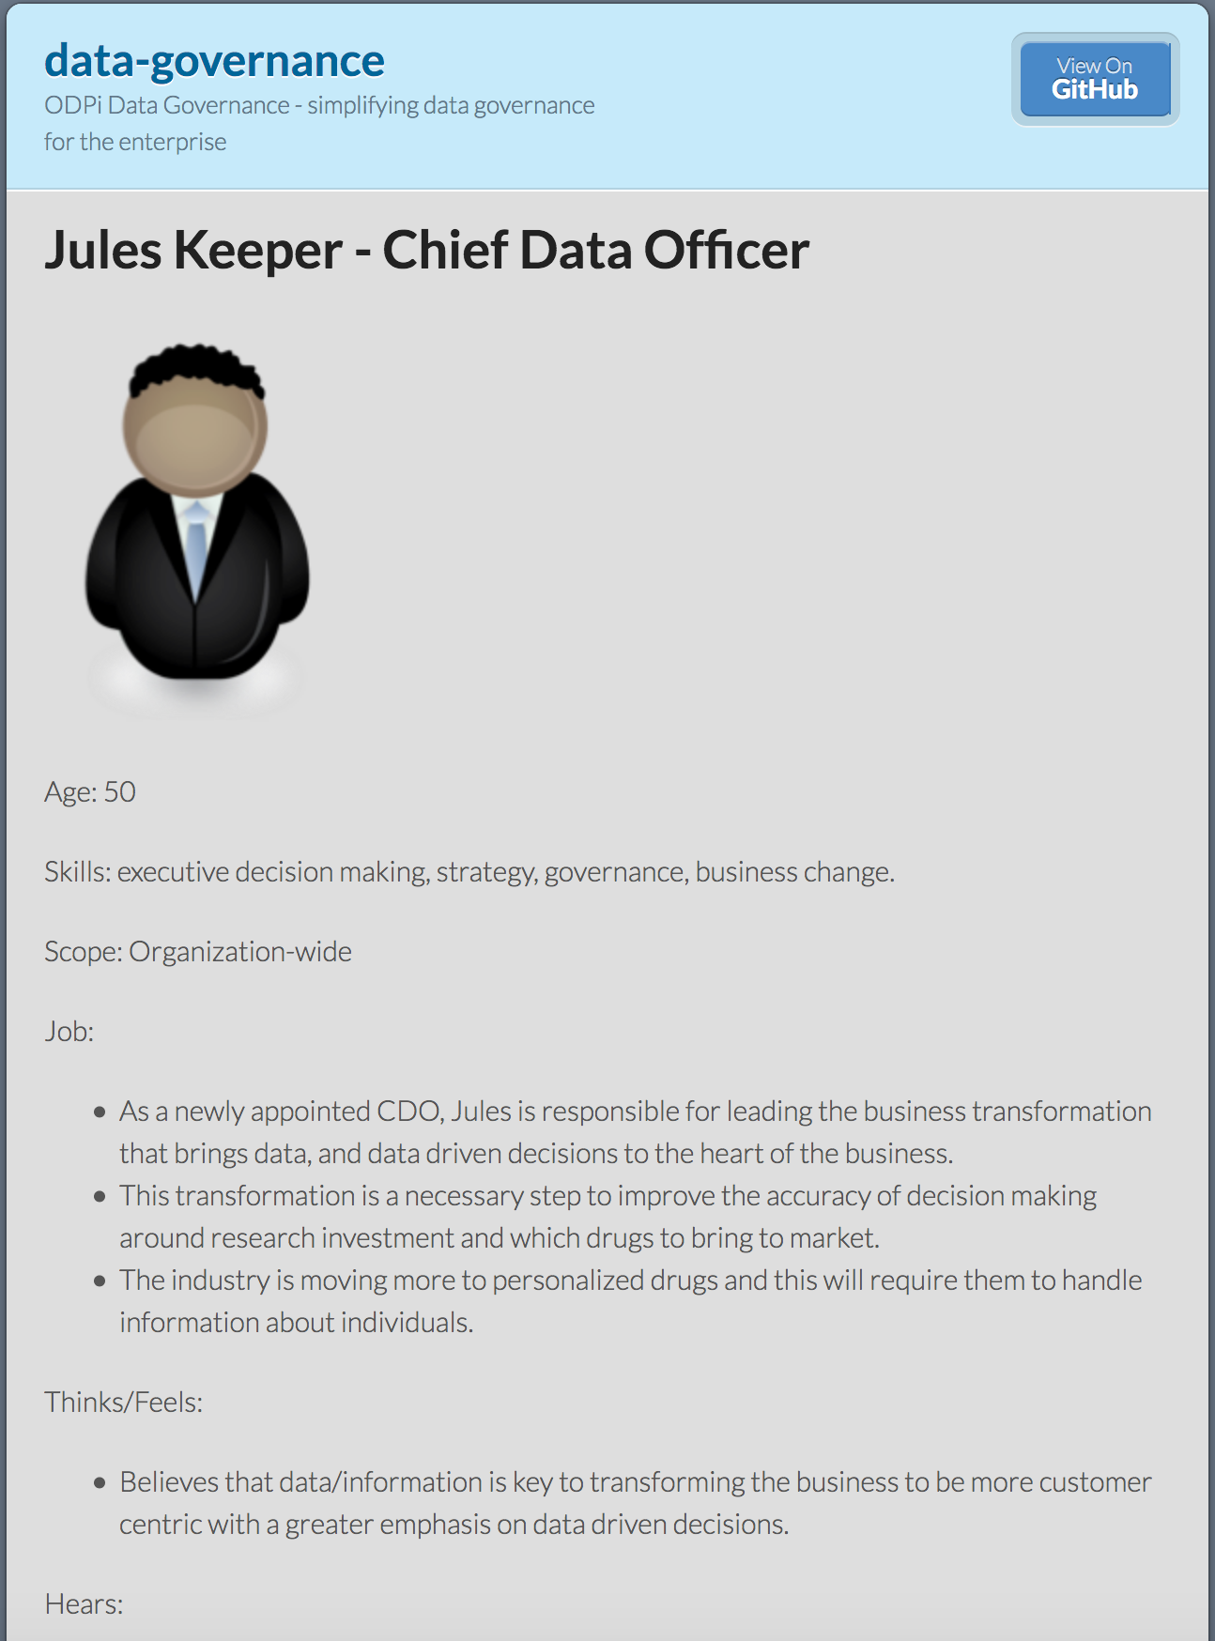
Using design thinking
Open Metadata Types
Access Service Identification
Samples and API design
Best Practices

Slide 52


Different personas need different services
Callie Quartile
Data Scientist
Find data
Understand data
Manage analytics models
Build data strategy
Define governance program
Monitor progress
Jules Keeper
Chief Data Officer

Slide 53


Different personas need different services
Tanya Tidie
Clinical Trials Administrator
Maintain accurate patient records
Catalog clinical trials data
Demonstrate good data management practices
Understand risks to organization
Set up protection
Monitor for suspicious activity
Ivor Padlock
Chief Security Officer

Slide 54


Event-driven governance
Assign
Owner
New
Database
Open
Metadata
Classify
Data
Use
Data

Slide 55
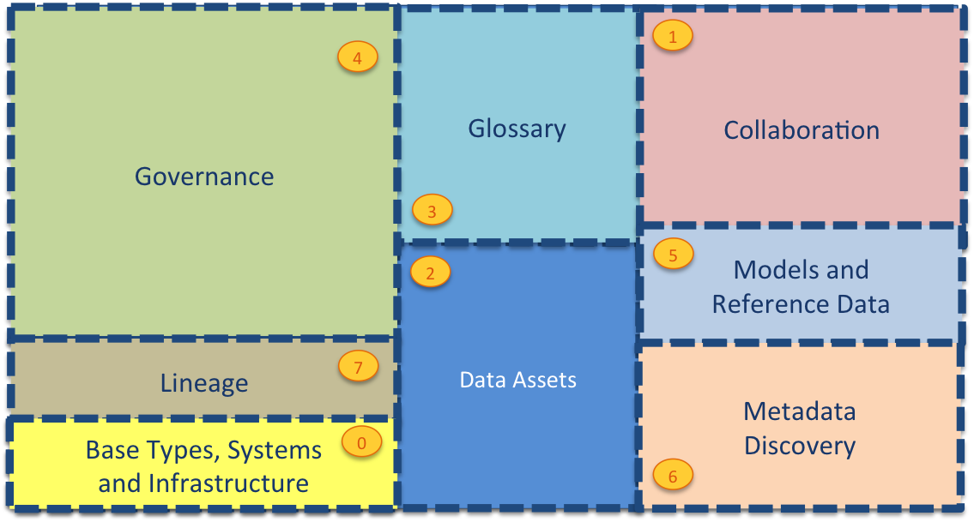
Current Open Metadata Access Services (OMASs)
Asset Consumer
Asset Owner
Asset Lineage
Subject Area
Asset Catalog
Community Profile
Stewardship Action
Project Management
Information View
Data Science
Governance Program
Software Developer
Data Privacy
Digital Architecture
Data Process
Data Protection
DevOps
Governance Engine
Data Infrastructure
Data Platform
Connected Asset
Discovery Engine

Slide 56
Open Metadata Access Service (OMAS) instance

Slide 57
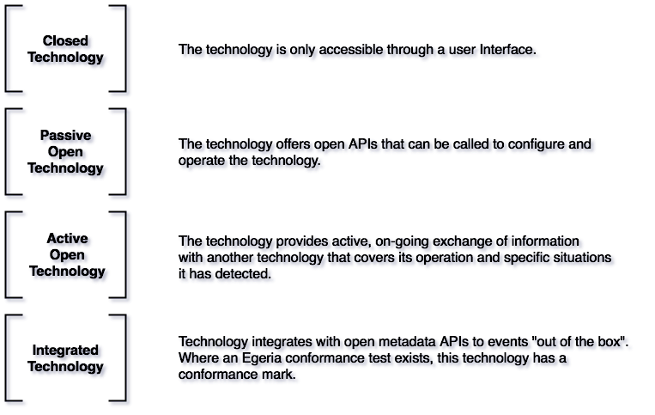
Metadata Tool Integration Patterns

Slide 58
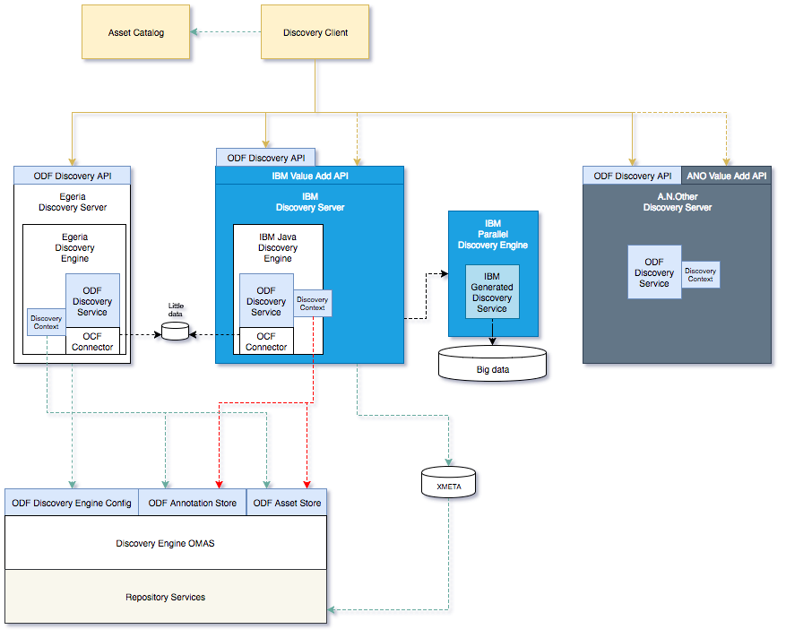
Metadata Tool Integration Patterns

Slide 59

Automating governance example
Define Policies
Hadoop Metadata
Open
Governance APIs
Access
Data
IBM
Information
Governance
Catalog
Apache Atlas
Egeria
configure
Gaian
configure
Apache Ranger
Manage Data Access
Egeria Cohort
(Open metadata exchange and federated queries)

Slide 60
Scared to share (example)
Very Sensitive Data
Very Sensitive Data
Faith Broker
Human Resources
00 3809890 6 7 Lemmie Stage 818928 3082 4 New York 4 27 DataStage Expert 1 45324 300 27 Code St Harlem NY 1 3
00 3809890 3 7 Callie Quartile 328080 7432 5 New York 4 27 Data Scientist 1 56944 045 27 Code St Harlem NY 1 3
00 3809890 1 7 Tanya Tidie 209482 4051 2 New York 4 27 Data Steward 1 43800 215 27 Code St Harlem NY 1 3
00 3809890 6 7 Lemmie Stage 818928 3082 4 New York 4 27 DataStage Expert 1 ##### ### 27 Code St Harlem NY 1 3
00 3809890 3 7 Callie Quartile 328080 7432 5 New York 4 27 Data Scientist 1 ##### ### 27 Code St Harlem NY 1 3
00 3809890 1 7 Tanya Tidie 209482 4051 2 New York 4 27 Data Steward 1 ##### ### 27 Code St Harlem NY 1 3
Callie Quartile
Data Scientist

Slide 61
What does metadata look like?
Business
metadata
IS-A
Employee
Sensitive
HAS-A
Work Location
HAS-A
HAS-A
Hourly Pay Rate
Manager
Compensation Plan
HAS-A
IS-A
HAS-A
Job Title
IS-A
HAS-A
Employee Id
Annual Salary
Employee Name
Structural
metadata for
a data store
EmpName
EmpNo
JobCode
Salary
Employee Record
Data
00 3809890 6 7 Lemmie Stage 818928 3082 4 New York 4 27 DataStage Expert 1 45324 300 27 Code St Harlem NY 1 3
Notes:
Business metadata describes the data that the business needs, what it means and how it should be classified and protected.
Structural metadata describes how the data is actually stored and labelled in the data store.
The linkage between the business and technical metadata allows our technology to switch between these two perspectives. For example,
A request for data expressed in business terminology can be translated into a query for data from a data store.
An integration engine copying data into a sand box can discover which are the fields that the business classifies as sensitive and then mask these values dynamically.

Slide 62
Automating governance example
Define Policies
Hadoop Metadata
Open
Governance APIs
Access
Data
IBM
Information
Governance
Catalog
Apache Atlas
Egeria
configure
Gaian
configure
Apache Ranger
Manage Data Access
Egeria Cohort
(Open metadata exchange and federated queries)

Slide 63
Governance maturity seen in terms of Value and Scope

Slide 64
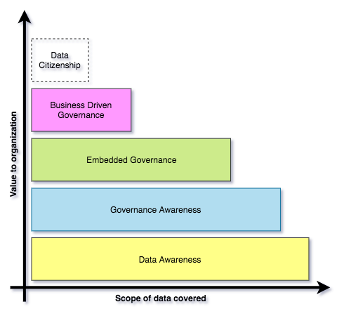
Building governance maturity is a gradual process
Organizations may operate different levels of maturity in different parts of their business.
Choices determined by where the most value lies.
Many organizations aspire to provide all employees with the data they need (data citizenship*)
https://opengovernance.odpi.org/maturity-model/

Slide 65
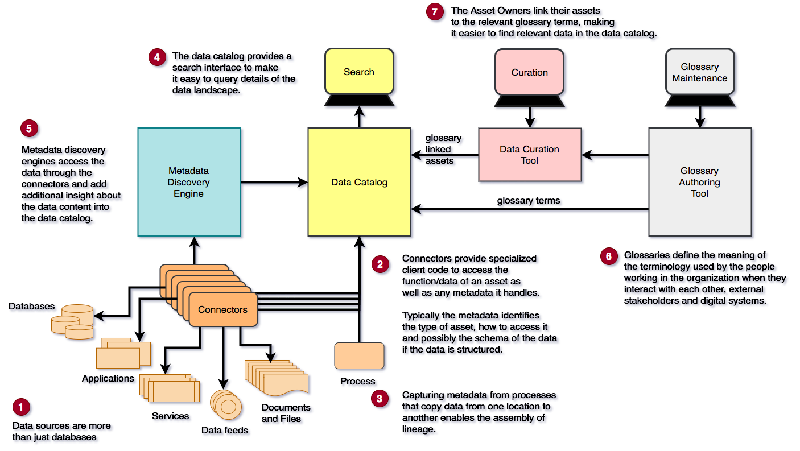
Implementing Data Awareness

Slide 66
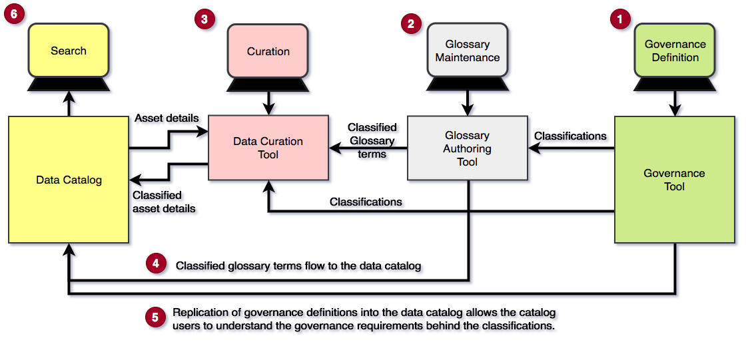
Implementing Governance Awareness

Slide 67
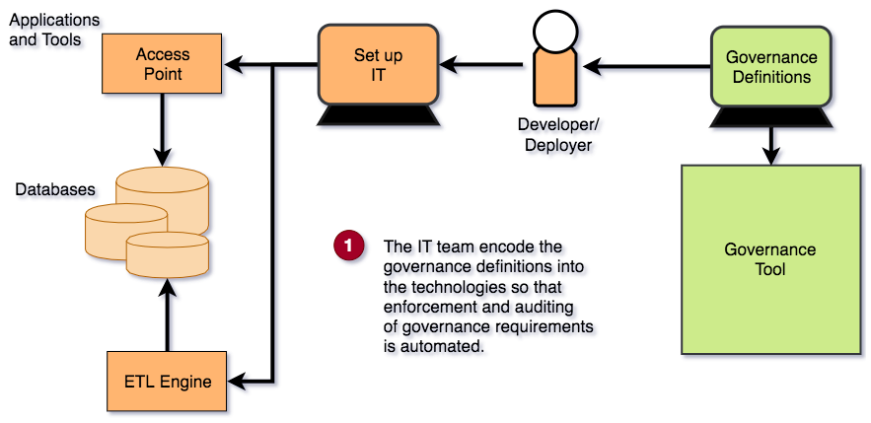
Implementing Embedded Governance

Slide 68
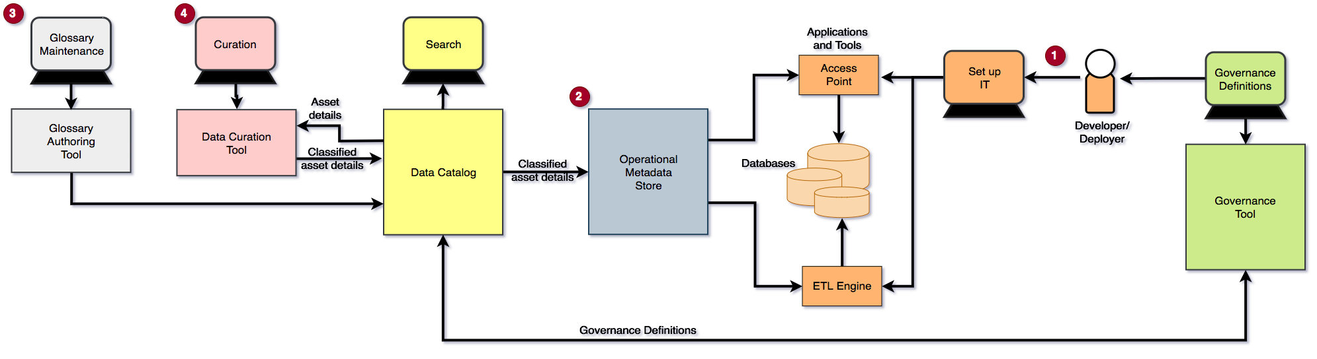
Implementing Business Driven Governance

Slide 69
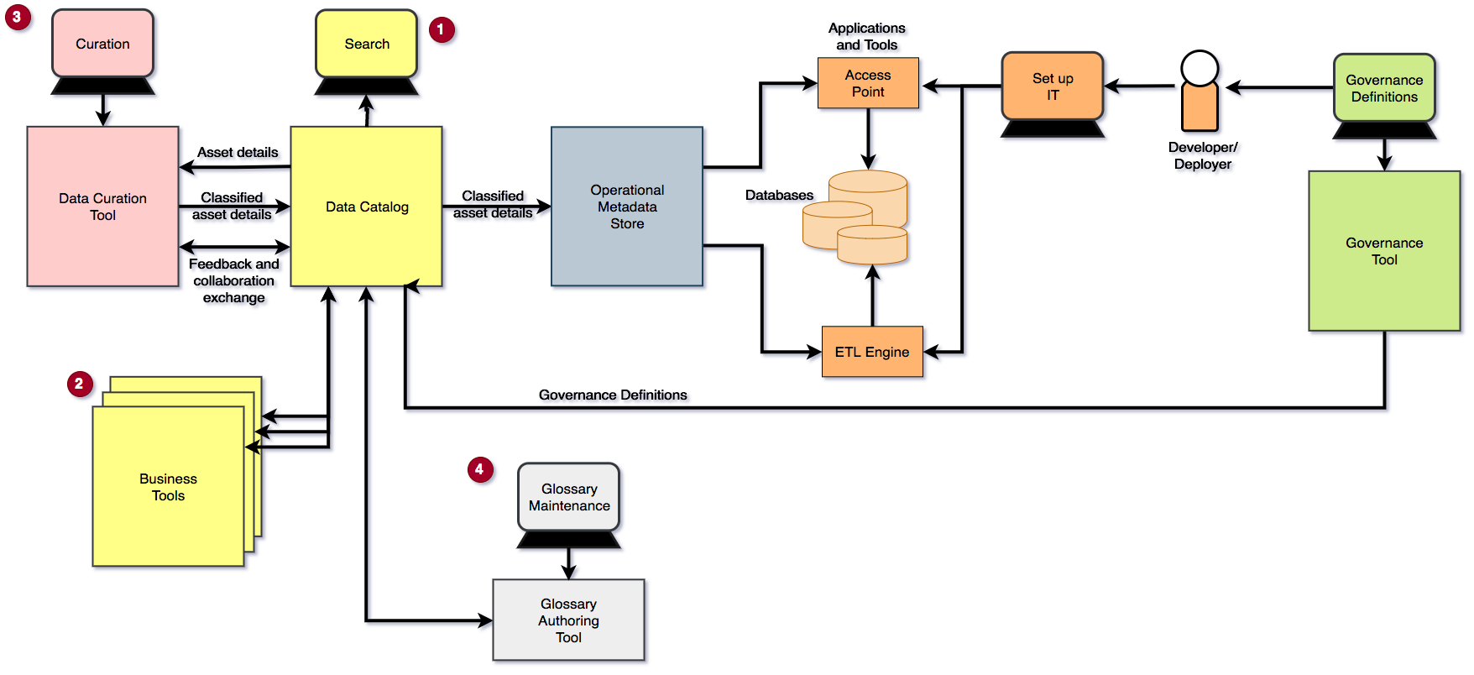
Implementing Data Citizenship

